Slide 1
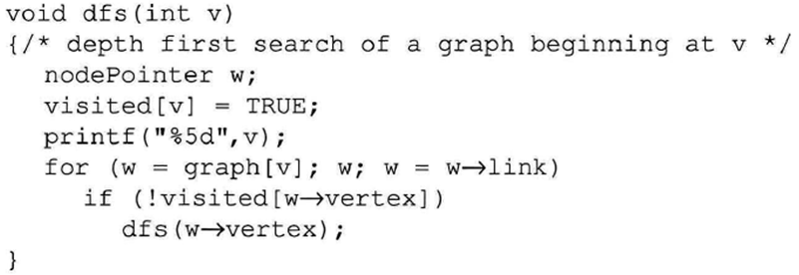
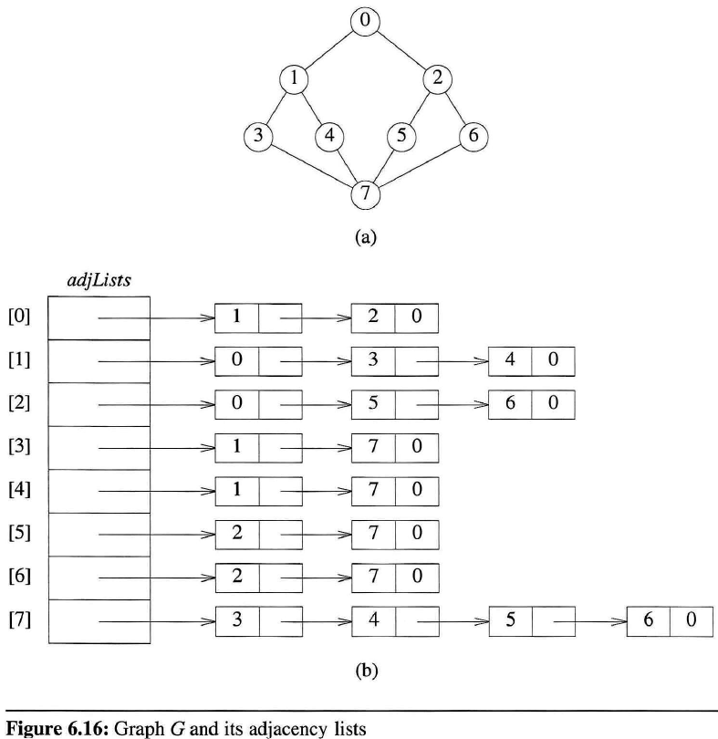
dfs(0)
output
0
1
3
7
4
5
2
6
graph
w₀
w₀
[0] | [1] | [2] | [3] | [4] | [5] | [6] | [7]
0 | 0 | 0 | 0 | 0 | 0 | 0 | 0
w₀ : NULL
visited
T
T
T
T
T
T
T
T
w₁
w₁
w₁
w₂
w₂
w₂
w₁ : NULL
w₂ : NULL
dfs(6)
w₃
w₃
dfs(2)
w₄
w₄
w₃ : NULL
dfs(4)
w₄ : NULL
dfs(5)
w₅
w₅
dfs(7)
w₅ : NULL
w₆
w₆
w₆ : NULL
dfs(3)
w₇
w₇
w₇
w₇
dfs(1)
w₇ : NULL
dfs(0)
<system stack>
※ push/pop of the activation record of dfs()
Notes:
We can verify that dfs(v0) visits all vertices connected to v0.
This means that all the vertices visited, together with all edges in G incident to these vertices, form a connected component of G.

Slide 2
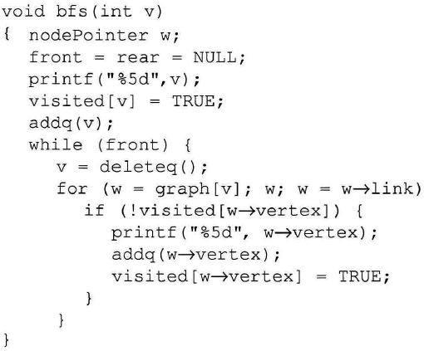
bfs(0)
graph
w
w
w : NULL
w
w
w
w
w
w
w : NULL
output
0
1
2
3
4
5
6
7
w
w
w : NULL
w : NULL
[0] | [1] | [2] | [3] | [4] | [5] | [6] | [7]
0 | 0 | 0 | 0 | 0 | 0 | 0 | 0
w
w
visited
T
T
T
T
T
T
T
T
w
w
w : NULL
w : NULL
queue
w
w
w : NULL
0
1
2
3
4
5
6
7
w
w
w
w
w : NULL
Notes:
As was true of dfs, all the vertices visited, together with all edges incident to them, form a connected component of G.

